Slide 1
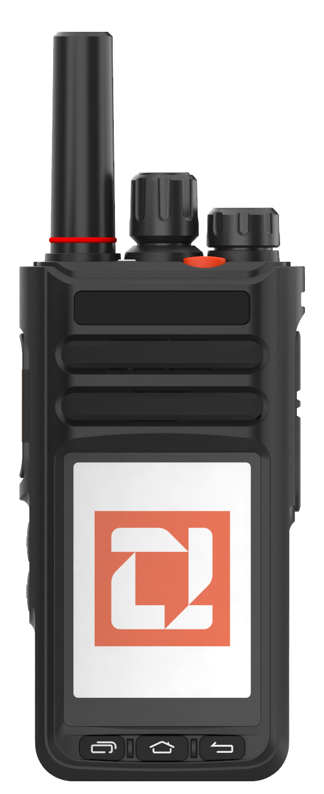
Indicator light
Channel selection
Antenna
SOS
Long press to Turn on/off
Short press Zello the silent switch
Rotate volume key
PTT
Earphone
PTT2
USB
TYPE-C
Long press the
lock screen switch Short press the screen to wake up / turn off the screen
Touch screen
Back
Recent
HOME

Slide 2
No. | Item | Description
1 | Indicator Light | 1: Charging indicator 2: Network indicator 3: When PTT is pressed, the broadcast light turns red, and when receiving audio, the light turns green
2 | Channel Knob | 1: Rotary encoder. 2: Use to select channels up and down when in the intercom APP.
3 | Power + Volume | 1: Long press to power on/off 2: Short press for global mute and to turn on the speaker 3: Clockwise to increase volume, counterclockwise to decrease volume, and tone changes according to volume size
4 | SOS | Alarm button
5 | PTT | Broadcast transmission button
6 | Side Upper Key | 1: Secondary PTT key 2: Customizable key
7 | Side Lower Key | 1: Short press to turn off and wake the screen 2: Long press to lock/unlock screen, with prompts for unlocking before further operations. After locking, only the PTT button works, other buttons are disabled but can still wake the screen. (Designed to prevent accidental operations during tasks) (Note: If the lock screen key is not enabled, the system enters sleep mode. Any key press will wake the screen.)
8 | Menu Key | Press to view recently opened and used software
9 | Home Key | Press to return to the home screen from any page
10 | Back Key | Returns to the previous step and exits
11 | Screen | 2.4-inch color touchscreen

Slide 3
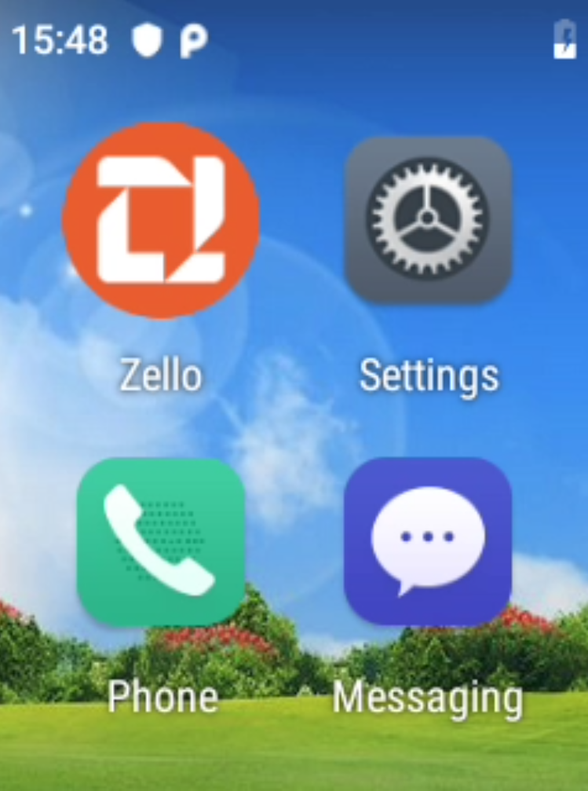

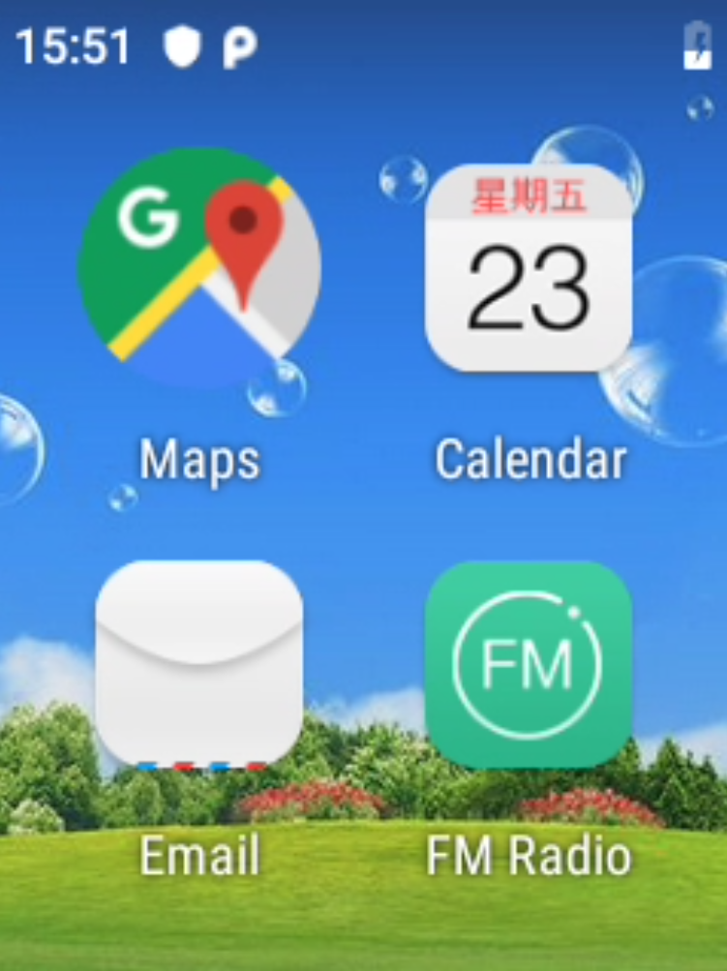
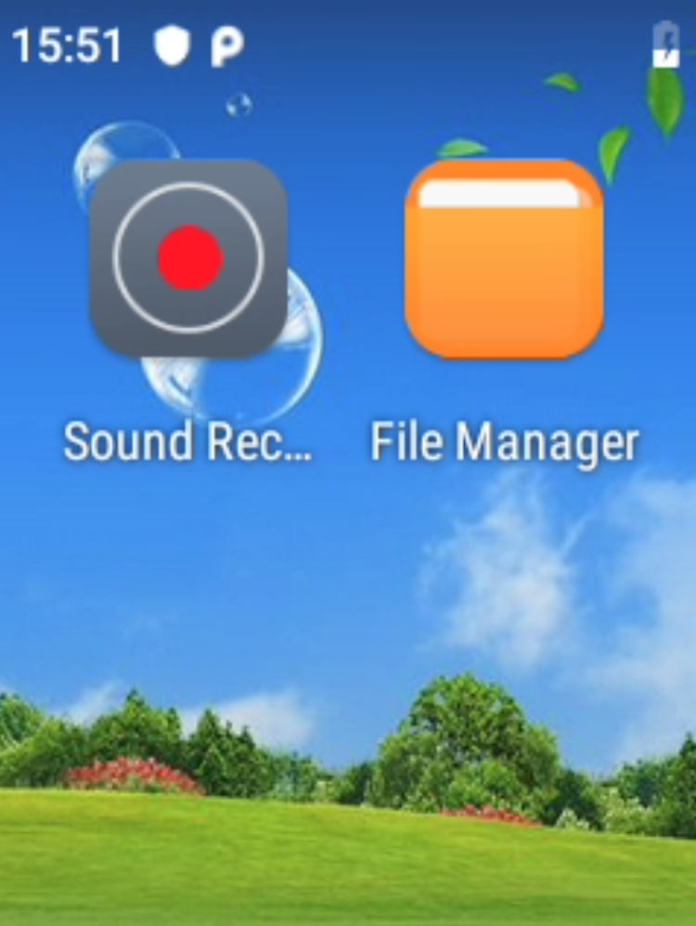
应用如下

Slide 4
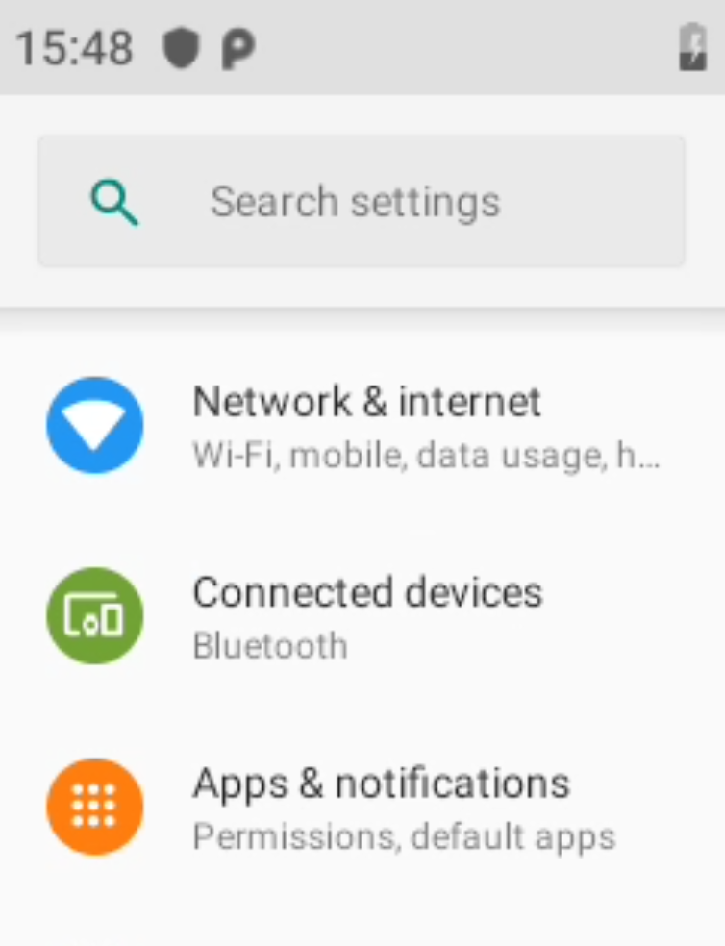
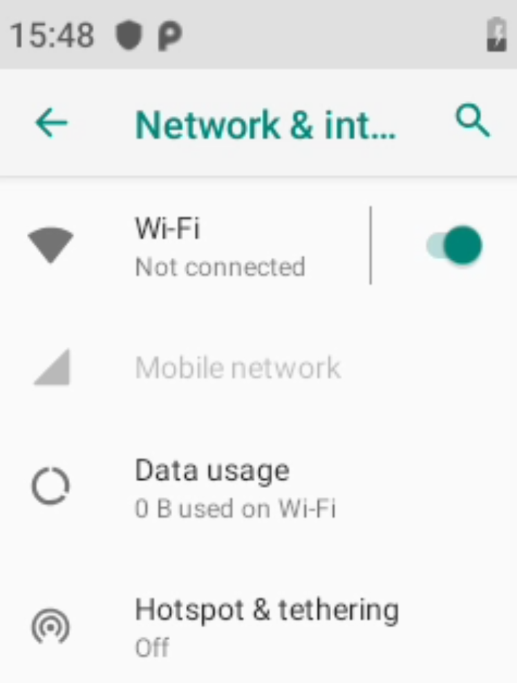
Set up network
Settings-Network and Internet-Turn on WLAN to connect to WIFI or use a data card

Slide 5
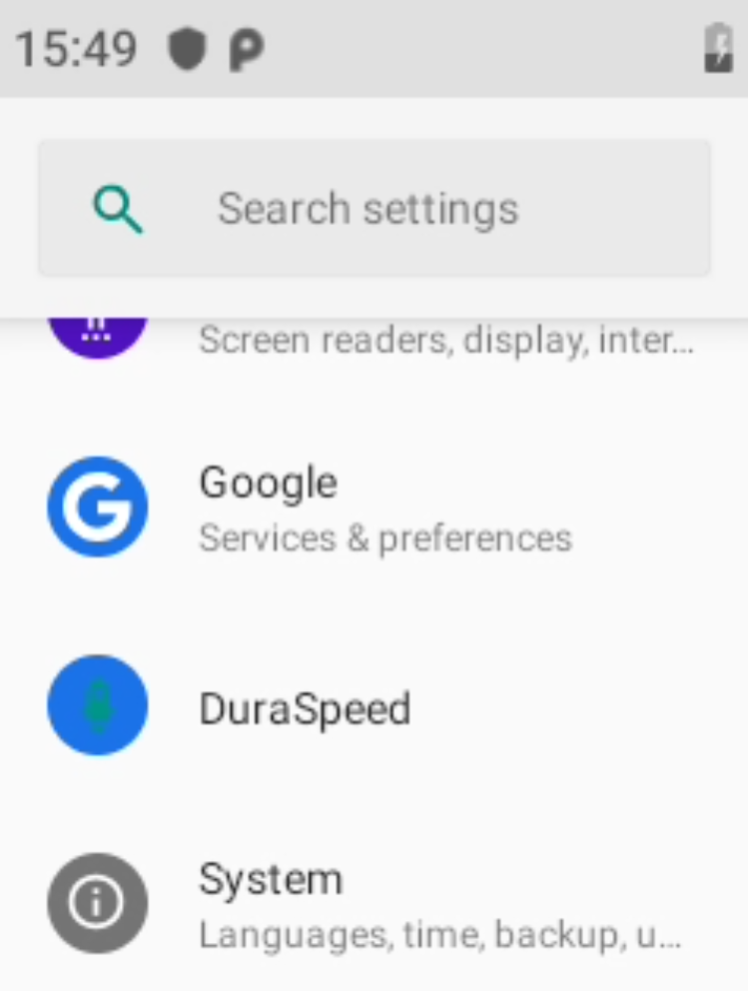
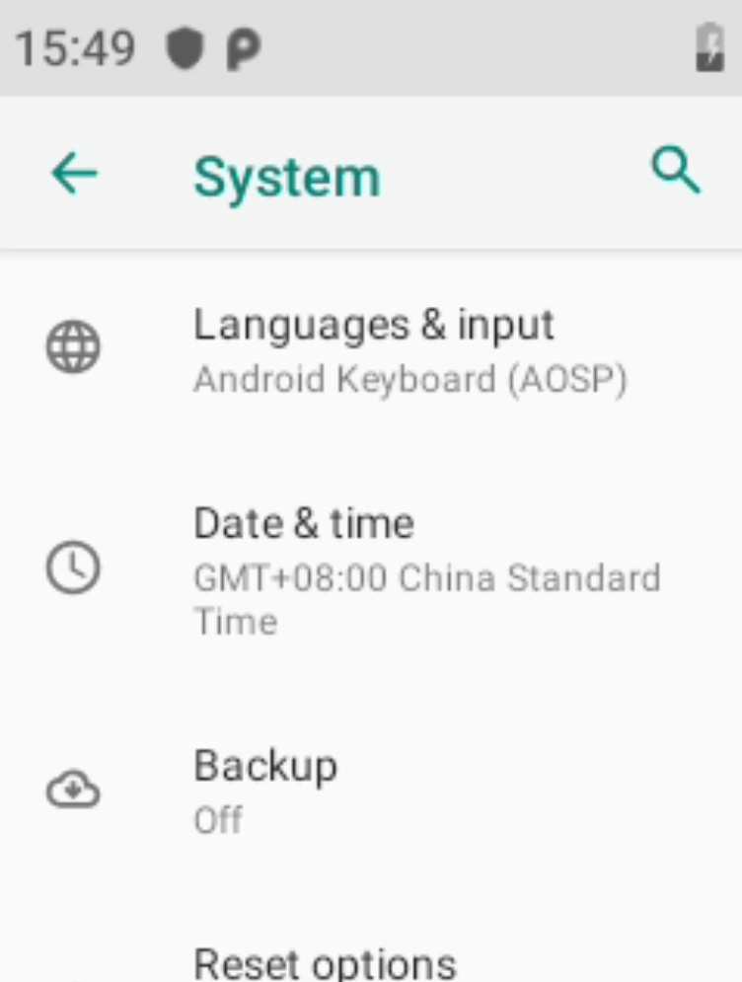
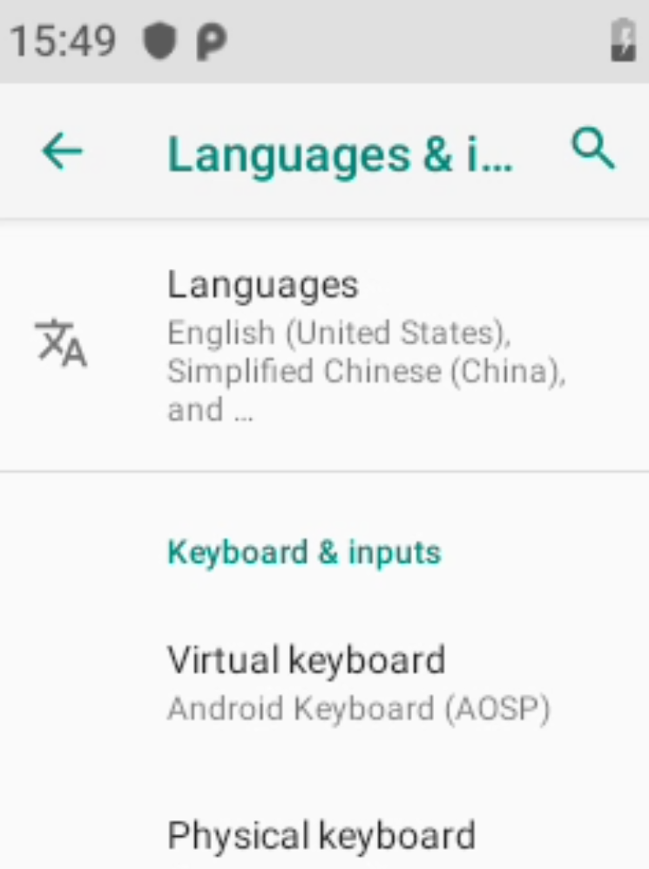
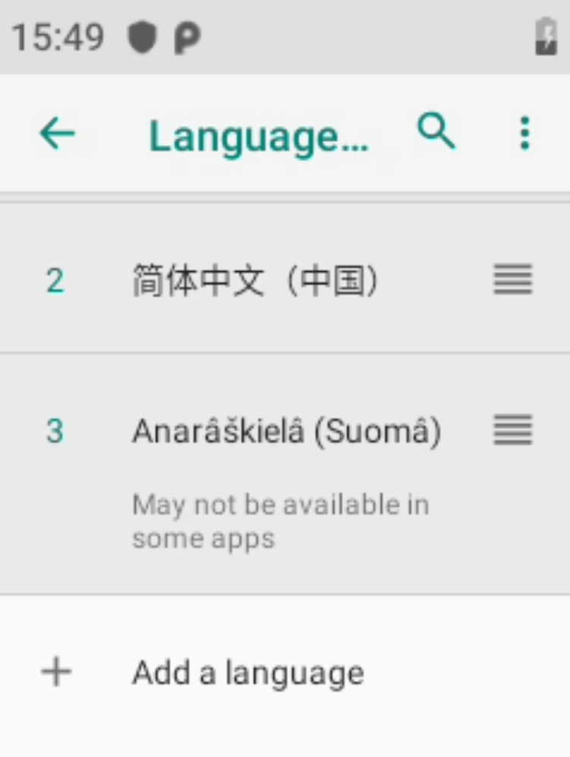
Set language
Settings-System-Language and Input Method-Language-Add Language. After selecting the language, you need to move it to the top to take effect.

Slide 6
SPEC
Processor | MTK6739 quad-core ARM
Band | 2G GSM850/900/1800/1900MHz
 | 3G WCDMA:B/1/2/5/8
 | 4GFDD:B1/3/5/7/8/20/28A/28B
 | 4GTDD:B38/39/40/41
System | Android 9
Memory body | 4G+16G
LCD screen | 2.4"TFT+Touch
Bluetooth /WiFi: | Support
GPS/BD | Support
Speaker | 2W
SIM card | NANO SIM
TF | Support
Dimensions | 110*55*33(MM)
Working environment | -20°C~85°C
Level of protection | IP54
1nterphone | Single hang 3.5 with PTT
USB | TYPE-C

